Slide 1
Double check your results manually
How to use calculator and how to save as a pdf so reading and printing
using a tablet or computer for measuring bend angles
The calculators have been thoroughly tested and are functional but it is always good practice to double check your results manually. There's a section that walks you through doing the math. Not difficult just follow the instructions. It's all just add, subtract, multiply, divide. No more than that.
A4 vs letter size Metric vs standard
List of materials and their properties Weight density thermal capacity
Where to Store struts in duffle bag Storage?
Show what finished product looks like at the beginning.
Domes in different biomes Hot and dry Cold and wet Cold and dry Hot and wet
Closed captions
Dome class selection in Clinton's image of dome classes Make into circle since class one meets back
Divisions of the fullerene tube
Add floor
Add Disaster protection
Add troubleshooting
Lightning strikes are rare Think much like a car wreck Doesn't mean you shouldn't wear a seatbelt
Show progression of strut fabrication
Timeline documentary commentary
Site is explained from stickman in logo
Color code titles in webpages Ex. Strut material red
Panorama of strut progression in fabrication

Slide 2
Building Dome Models
Paper tube held together by staples brass tacks
sticks and clay balls
Reciprocal Frames
For flooring
Suspening a floor or stairs from dome roof
Stairway spiral on dome golden ratio
Pit greenhouse geodesic dome
Plastic gets more brittle at lower temperatures
Woven dome with tree branch and rope
Mirrors increase solar output
It is important to understand the angle of repose. How different materials slope under gravity. Providing walls that are load bearing.
Building a second to attach upside down on the big dome for a second story
Cons low profiles dome won’t offer as much interior space. This create a issues with standing space headspace if the dome isn’t tall enough.
mylar hammock
Geodesic dome from lashing poles together, use tripod lashing. Use tripod 2x4 as roof flooring Adjustable legs 2x4 on base Use 1/2 conduit for leverage on shop press Where is a tripod's center of gravity The people only method top-down and bottom-up. Don't pull the block and tackle Getting power from your car
Building a quick model. Sheets of paper, hole punch, brass tacks. Test with sheets of paper for your cover on paper model dome
Use smaller dome as center point of dome. Works as center of second floor
Reinforcing observation deck with space frame at top.
Elevator that is pulled up onto the observation deck from tip of icosahedron
Flying a flag on your observation deck
Base diameter is from side to side Not point to point
Rope and lash hubs Woven PVC 2 Bucky balls overlap
Compressed air struts Concrete mâché struts
Use 5 gallon buckets to create a form or use the buckets themselves for footings
Rock climbing dome Center pillar for vertical climbing Pillar is a Bucky tube
You can get sand by the ton from rock quarries $10 or less usually. Don't buy from lowes Home Depot. 50 pounds for $5 is not a good deal compared to what the quarries offer.
If you're imperial, it may help to measure your cuts according to inches not feet, you may find your self accidentally cutting 2 ft 2 in instead of 3 ft 2 in. I know this from personal experience
Apply an electric charge to make something translucent
Diamond ladder along with climbing harness to move around the dome
Anchored tripods vs tetrahedrons
Build one dome easy to upgrade, compatible chord factors
Making multiple domes that will also make a larger one.
Easy way to remember dome struts for different frequencies.
Hubs made from woven rebar
Pit greenhouse geodesic dome
Plastic gets more brittle at lower temperatures
Woven dome with tree branch and rope
Mirrors increase solar output
It is important to understand the angle of repose. How different materials slope under gravity. Providing walls that are load bearing.
Building a second to attach upside down on the big dome for a second story
Cons low profiles dome won’t offer as much interior space. This create a issues with standing space headspace if the dome isn’t tall enough.
mylar hammock
Geodesic dome from lashing poles together, use tripod lashing. Use tripod 2x4 as roof flooring Adjustable legs 2x4 on base Use 1/2 conduit for leverage on shop press Where is a tripod's center of gravity The people only method top-down and bottom-up. Don't pull the block and tackle Getting power from your car

Slide 3
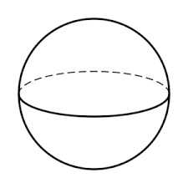
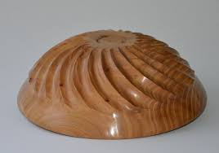
Overview
Sphere is the most efficient closed shape.
The dome is the most efficient open shape.
The bigger the shape, the more efficient it is in terms of SA/V ratio.

Slide 4
Overview
When looking to build a structure, you will need to start with shapes.
So what the best shape?
Let's start in the 2 dimensions.
The circle has the lowest perimeter to high area ratio.
Meaning it can cover the greatest amount of area with the shortest perimeter.
If someone gave you a line and you were asked to connect the ends to form a shape, this is essentially what you would be doing.

Slide 5
Overview
But there is also another way to cover more area, if we use the ground as part of our shape.
If we truncate the shapes (cut in half or quarters).
And we get an arch, that covers the most area for the shortest perimeter.
How big is the difference between the other shapes?

Slide 6
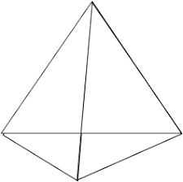
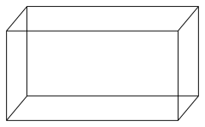
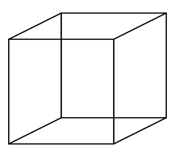
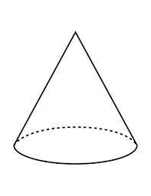
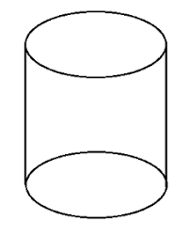
Overview
Now that we have covered 2 dimensions and learned that a circle is best.
Let us move on to 3 dimensions.
What perimeter is in 2d, surface area is in 3d.
What area is in 2d, volume is in 3d.
So instead of a perimeter to area ratio, we want a surface area to volume ratio.
So this may lead us to believe that a sphere ought to have the lowest surface area to volume ratio.

Slide 7
Overview
Like before, if we want to use the ground as part of our structure, then we can discount the base section of the shape.
We truncate our sphere.
And we are then left with a 1/2 sphere being the best shape as far as surface area to volume is concerned. How big is the difference between the other shapes?

Slide 8
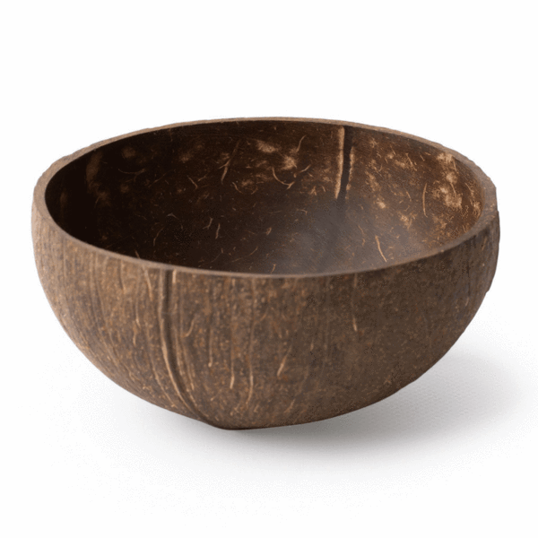
Overview
A 1/2 sphere then is the best shape for containing space.
We can imagine this being done in two ways.
If the 1/2 sphere were to be resting on its peak, we are left with a bowl.
Or
If the 1/2 sphere were resting on its edges, we are left with a dome.

Slide 9
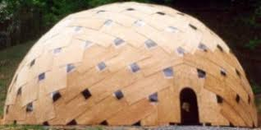
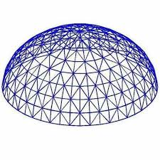
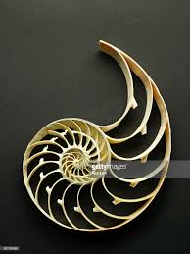
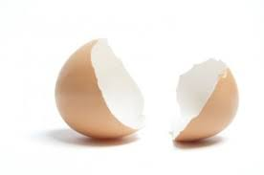
Overview
Last time we learned that a dome is the most efficient shape.
But now we faced with the challenge of building a dome.
There are two common approaches:
Begin with a frame and cover with panels
Or
Monocoque

Slide 10
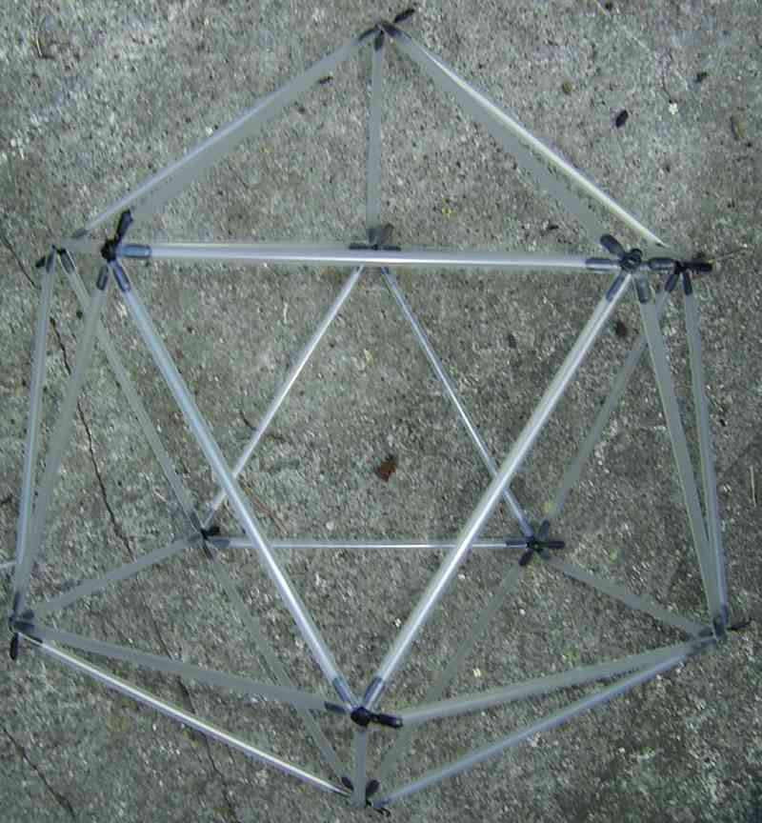
Overview
How to create a frame for a dome.
Two approaches.
We can create a frame by taking one line and form the shape.
Or
We can take individual pieces and connect at nodes or hub sections.
The hub method offers portability.
The best way to make a dome from straight pieces, is to find some way of approximating a dome.
The icosahedron has the most approximate geometry to a dome.
We start there and must a move to a field called geodesics.

Slide 11
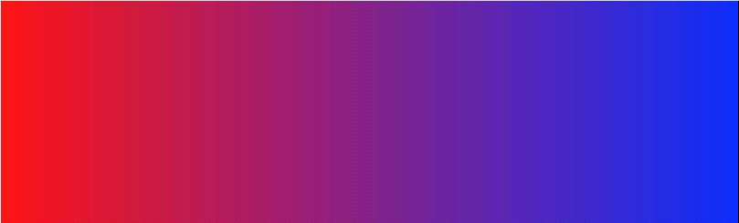
if a sphere and an icosahedron had a baby then it would be a geodesic sphere. She has your vertices. And your faces.

Slide 12

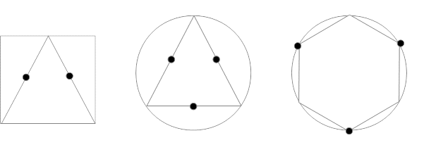
Overview
Geodesics work in a way as one would combine shapes together.
Much in the same way we might mix red and blue to get purple.
One can take a square and a triangle and make it into a new shape.
But a little more precision is required here.
We can't just begin mixing red and blue together.
How much red and how much blue is the question?
This will generate different shades of purple.
How much square and how much triangle?

Slide 13
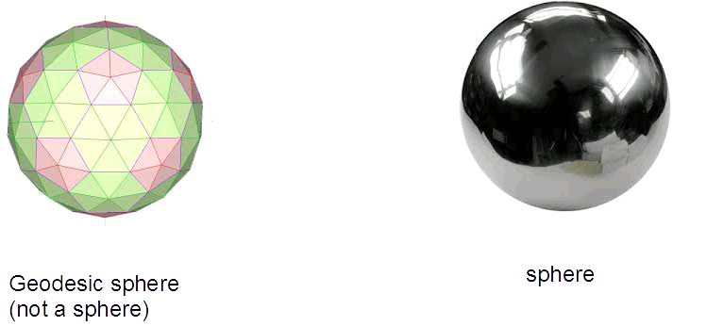
Overview
Approximating shapes to give us a sphere-like structure opens a lot of options.
But it is important to remember that these are only approximations of spheres/domes. So when things are calculated they should be done so with that particular geodesic dome in mind not a 1/2 sphere or dome.
For lower frequencies it is would more practical to think of them as better resembling an icosahedron than a sphere. For example, a cube has a eight sides, an icosahedron (1v) has 20 sides, a 2v dome would have 40 sides. An ideal sphere has an infinite number of sides.

Slide 14
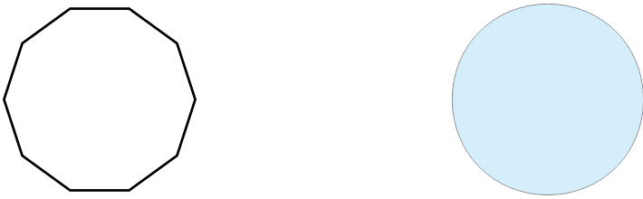
Overview
Following this, If we look the floor area of a 1/2 2 frequency dome. We will notice that it is not a circle, but a 10 sided shape also known as an decagon. There are many stated disadvantages to geodesic domes, one in particular is furniture. This should only be a concern if the strut length is shorter than the furniture itself.
Another solution is to build a higher frequency dome and/or bigger dome. The curves of the wall aren't as prominent with larger structures. Example think of the earth being a sphere. But it was once considered to flat for exactly this reason.

Slide 15
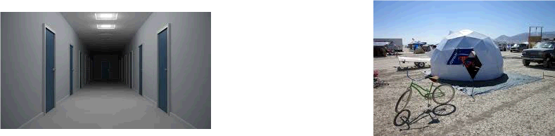
Overview
Why a dome might feel smaller than a rectangular room of the same size.
There are 2 likely reasons for this.
One is that even though you have a great deal of volume for the surface area. The lack of surface area is going to make the room feel smaller. The more surface area, the larger the room might feel. A long hallway may feel large because it has a tremendous amount of surface area even though it lacks very much volume.
Secondly, your dome might not be tall enough. The moment the dome starts to curve inward, you may be left with the feeling of cramped. The solution for this is to make sure the first row of the dome is the same height as you are or alternatively, make a riser wall for the dome. Seeing as people are usually between 5 to 6 ft. It would be a good idea to make the rows this tall on the mid-high frequency. The low frequency dome you may to have a riser wall instead. Or make another row that is completely vertical. Also may be good to add another 1ft or 2ft for head clearance for other movements like jumping.

Slide 16
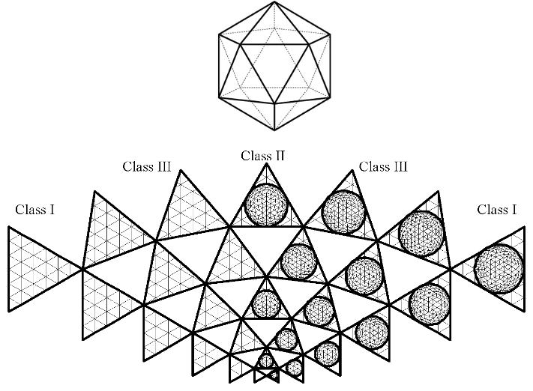
Class
So the first part of geodesics begin with dividing the shape up. We begin with an icosahedron. There are many ways to divide a shape up, but we are looking for features that allow for symmetry and equality. The methods of dividing are referred to as Class.

Slide 17
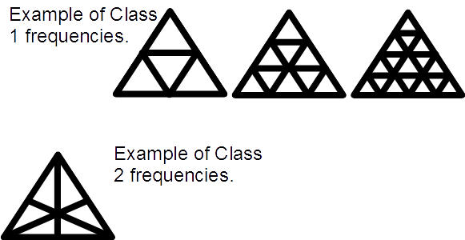
Frequency
Following the division, we will be posed with the question of how many times to apply this division. Class 1 for example supports any number of frequency. Class 2 on the other hand, only supports even frequencies.
Frequency as it increases will better approximate a dome or sphere. The idea is that higher frequency is better but it has ts disadvantages. To make up for these, the laminar dome (diamond dome) or spaceframe is used.
First off are the angle bends. These decrease with higher frequency therefore making the dome flatter. Flat isn't ideal when it comes to building. The dome can pop inward. At frequencies 8 and above domes will have angles at 4 degrees or less. The chart shows the angles. Hugh Kenner describes his recommendation.

Slide 18
Subdivision
Subdivision is somewhat like class but a more refined version of that particular class.
Examples of subdivision for Class 1 domes.
Subdivision Method 1 Equal Triangles More similar triangles
Subdivision Method 2 Equal Chords More similar struts
Subdivision Method 3 Mexican Fewer number of struts

Slide 19
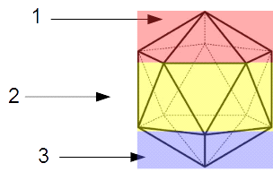
Profile
Since we are approximating our shape into a sphere, we gain more rows as we increase frequency. This allows us different portions of a sphere. However, if we move outside using a 1/2 sphere, our dome won't be as efficient as it could be. Dome profile 1/2 domes will provide you with a dome that has the most stability since it represents a sphere at its widest point.
Though you will also want to consider standing room for your dome. low profile you will want for high wind or if you want to cover a lot of floor space for less.
In order to figure up the number of rows on a sphere, we multiply the frequency times 3 (for an icosahedron).
For example,
A 1v icosa has 3 rows.
A 2v has 6 1/2 is 3
A 3v has 9
A 4v has 12 1/2 is 6

Slide 20
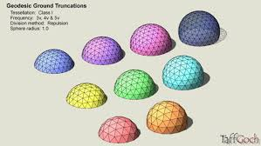
Truncation
After looking at profile, you may have noticed that the odd frequencies cannot be made into a 1/2 sphere. 1/2 sphere is the only part that is flat at the base for Class 1. To make use of a different dome profile other than 1/2, we will need to truncate the dome in order to get a flat base.
Note: Domes can be used without having a flat base but forces won't be distributed evenly across the dome. There are several ways of doing this. One involves altering the geometry of the dome. Kruscke method.

